Slide 1
Library Analytics: Borrowing Trends & Reading Behavior
Final capstone defense - Talibon Polytechnic College, A.Y. 2026-2027
Peter Paul Polestico (Project Lead / Analyst) | Ken T. Lubrico (Data Engineer) | Johnro Balingit (Statistician / Modeler, BI Developer)
Business problem
Three business questions
The library can't see who uses its collection or whether recommendations work for new (cold-start) patrons
Data: 12,000 patron-book events, Kaggle (synthetic - disclosed)
BQ1 Which patron types and departments borrow irregularly?
BQ2 Which categories and formats drive engagement?
BQ3 Are cold-start patrons underserved by recommendations?
Group 1 - The Data Bookworms | BED 106 Business Analytics | 1/7

Slide 2
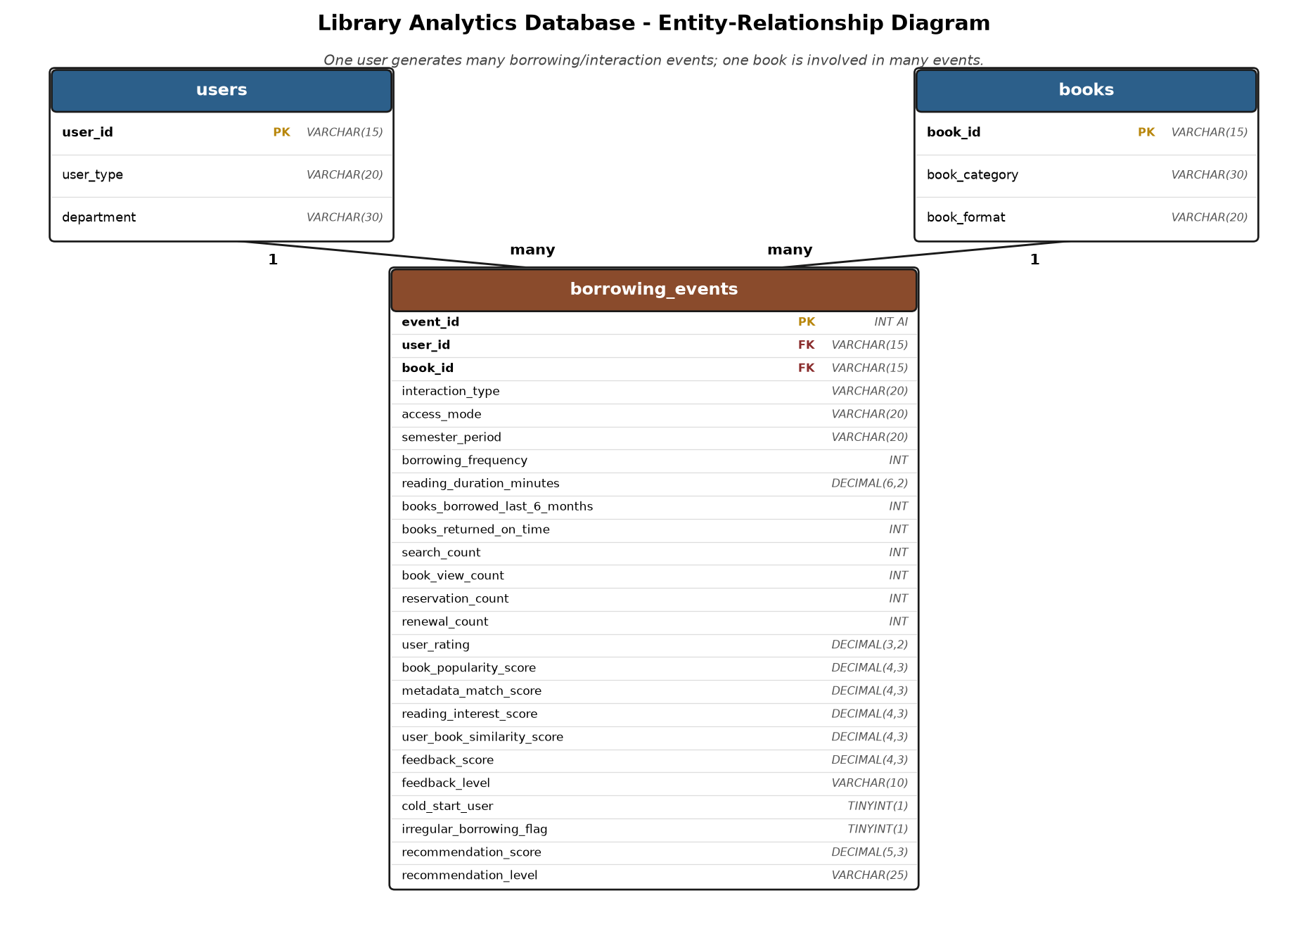
Data & SQL Overview
0.478 vs 0.574
17.1%
Avg recommendation score: cold-start vs established (Q8)
Irregular rate, Medicine - highest dept; spread not significant (Q6)
594-617
18.5%
Borrows per book format - format is not a demand driver (Q7)
Share of events from cold-start patrons
3 normalized tables: users, books, borrowing_events (fact)
No missing values or duplicates; Yes/No flags cast to 0/1
8 SQL queries: WHERE/ORDER BY, GROUP BY, JOIN, business questions
Group 1 - The Data Bookworms | BED 106 Business Analytics | 2/7

Slide 3
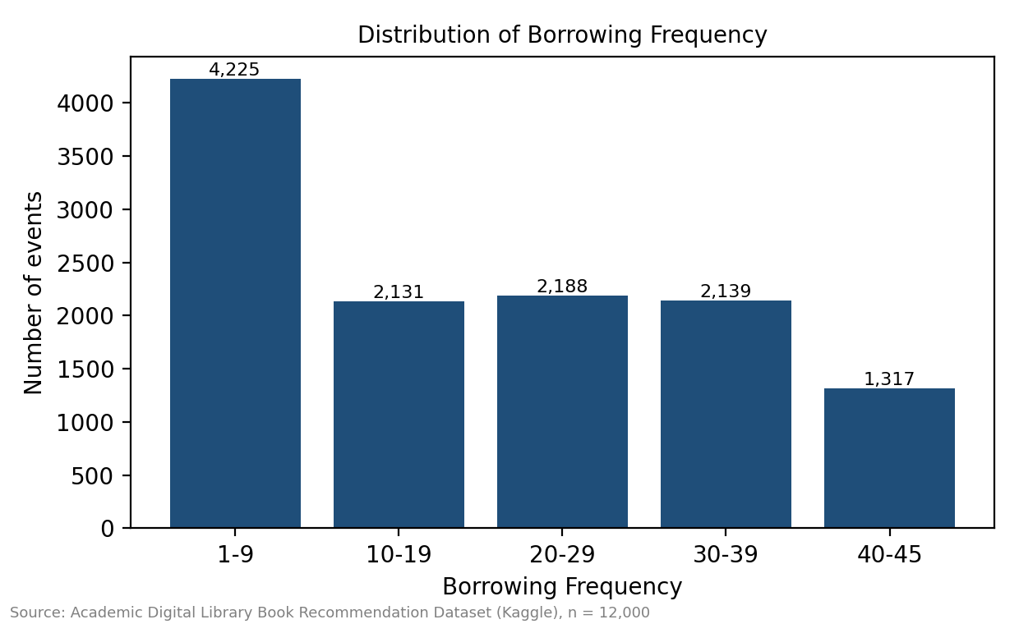
Statistical Insights
Borrowing frequency is right-skewed: 35% of events at 9 borrows or fewer, 11% at 40-45
Correlation with recommendation score: r = 0.51 (moderate, positive)
Simple regression: Score = 0.4823 + 0.003837 x Frequency
R-squared = 0.256, slope p < 0.001 - frequency explains only a quarter of the score
Next step: add more predictors (Checkpoint 4 model)
19.2
94.3 min
0.556
Avg borrowing frequency
Avg reading duration
Avg recommendation score
Group 1 - The Data Bookworms | BED 106 Business Analytics | 3/7

Slide 4
Live Dashboard Demo (Power BI)
Page 1
Page 2
Page 3
Executive Summary
Trend & Comparison
Segmentation
5 KPI cards, cold-start gap, irregular rate by department
Score vs borrowing frequency, categories, formats
K-Means k = 4: four named patron segments
What we will demonstrate live
Four synced slicers: User Type, Department, Semester Period, Segment, plus click cross-filtering
Filter Department = Medicine: irregular rate 17.1%, 1,524 events
Filter Segment = Casual / At-Risk Patrons (3,285 patrons, ~34% cold-start) vs Devoted Readers (score 0.641)
Switch to Power BI Desktop now
Group 1 - The Data Bookworms | BED 106 Business Analytics | 4/7

Slide 5
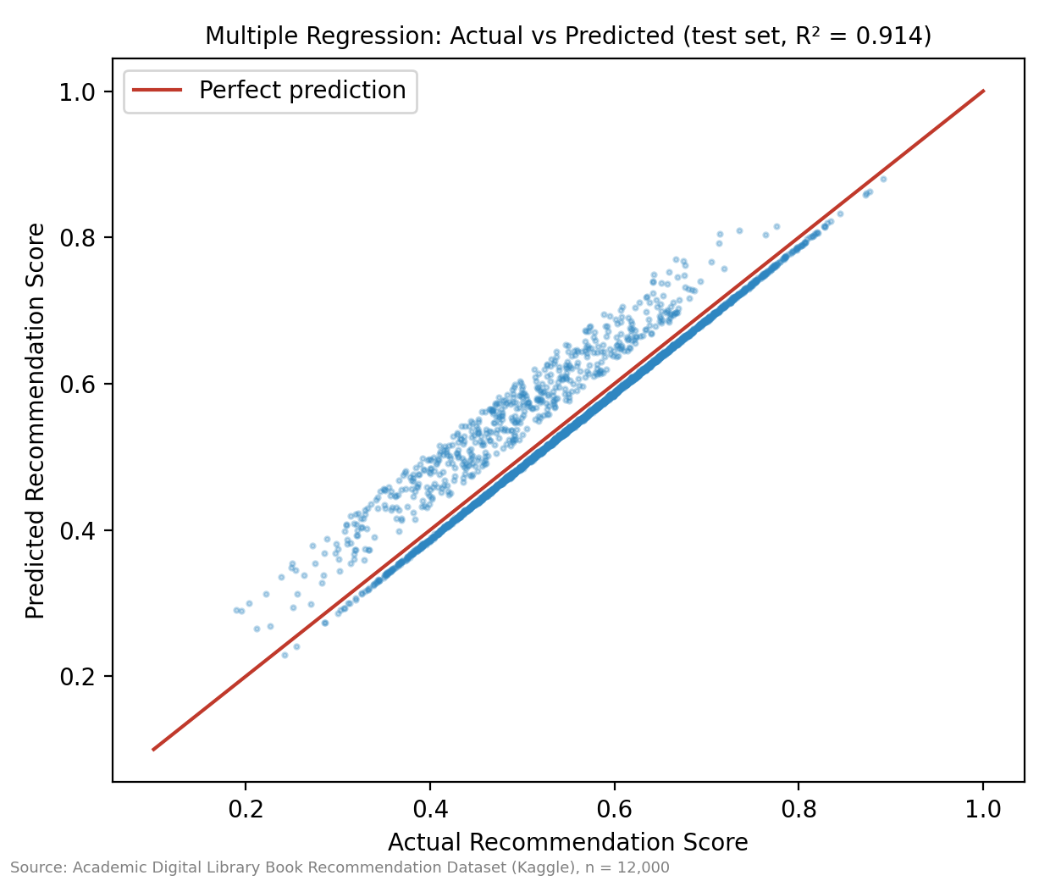
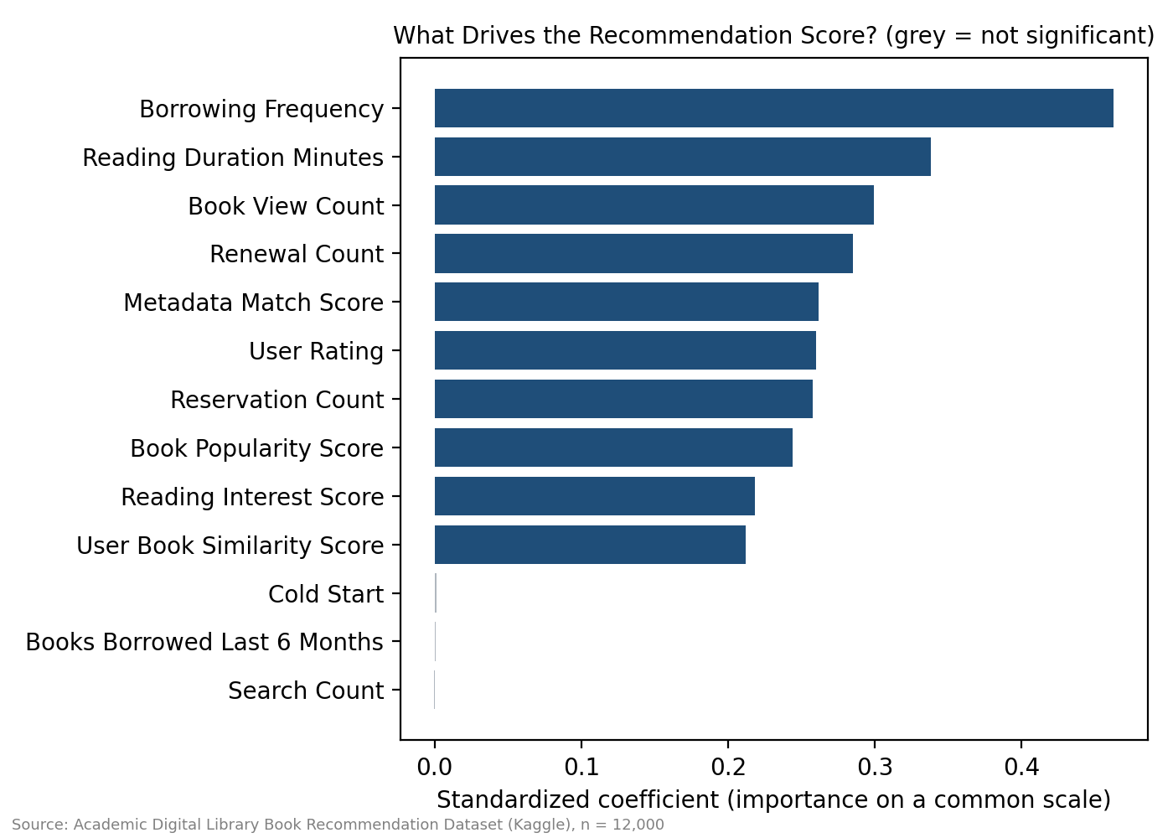
Predictive Analytics
R-squared 0.914
Multiple regression, test set (was 0.256)
94.6%
Logistic accuracy (baseline 84.0%); recall 78%
0.50 vs 0.57
Predicted score: new vs established patron
Strongest drivers: borrowing frequency, reading duration, views, renewals
Cold-start flag is NOT significant once borrowing frequency is in the model: the gap comes from thin history
Limits: synthetic data, score is algorithm output, association not causation
Group 1 - The Data Bookworms | BED 106 Business Analytics | 5/7

Slide 6
Recommendations
1
Fast-start onboarding for new patrons: first-loan lists, interest profile, post-first-borrow prompt
2
Segment-specific nudges: reminders, 'read next' lists, check-ins
3
Irregular-borrowing reminders library-wide, not by department (p = 0.81)
4
Better book metadata and richer patron interest data
5
Weekly early-warning list from the classifier, reviewed by a librarian
Group 1 - The Data Bookworms | BED 106 Business Analytics | 6/7

Slide 7
Ethics, Governance & Conclusion
Privacy
Ethical issues
No names or direct identifiers; coded patron IDs; synthetic data. Real data needs consent, aggregation, no re-identification.
New patrons score lower for equal effort. Never use segments, the irregular flag or the model to label or penalize individuals.
Governance
Regulation
Defined purpose, data minimization, role-based access, retention limits, regular fairness checks, transparency.
Data Privacy Act of 2012 (RA 10173): transparency, legitimate purpose, proportionality; GDPR as benchmark.
New patrons are underserved because of thin borrowing history, not because they are new. Thank you - questions?
Group 1 - The Data Bookworms | BED 106 Business Analytics | 7/7

